Slide 1
COVID Simulation Visualization
@EC_GO

Slide 2
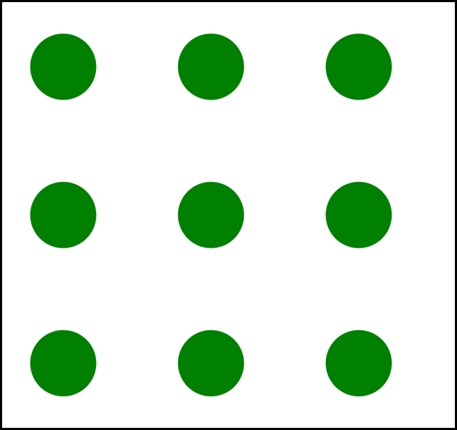
Consider a population of uninfected GREENS

Slide 3
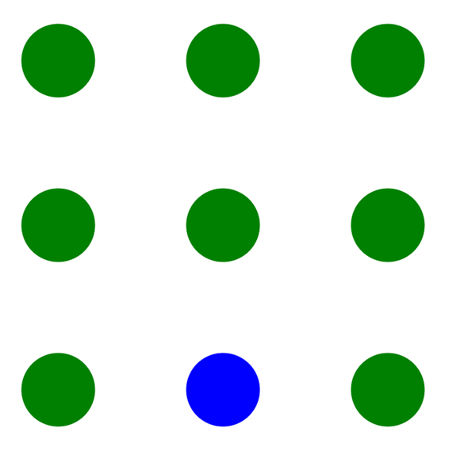
If one turns BLUE (spreader)
MODEL IS: IF NO CONTACT, NO TRANSMISSION!!

Slide 4
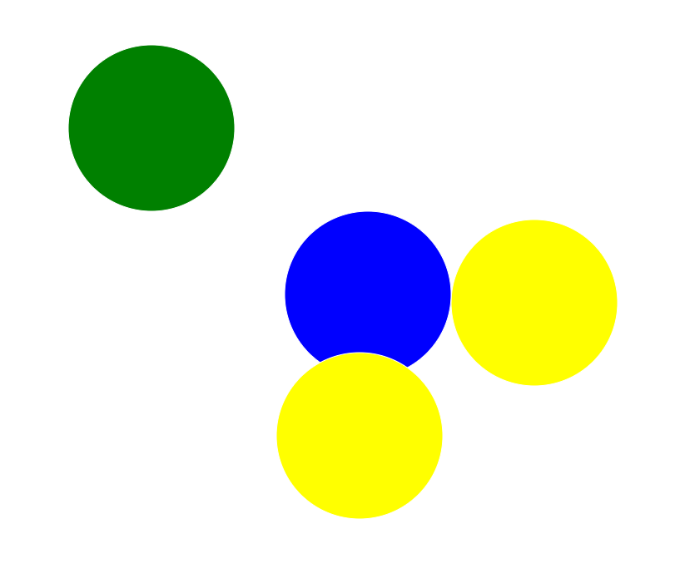

GREENs touched by BLUE turn YELLOW
INFECTED AND WILL INCUBATE FOR [days] before turning BLUE
Can set parameters

Slide 5
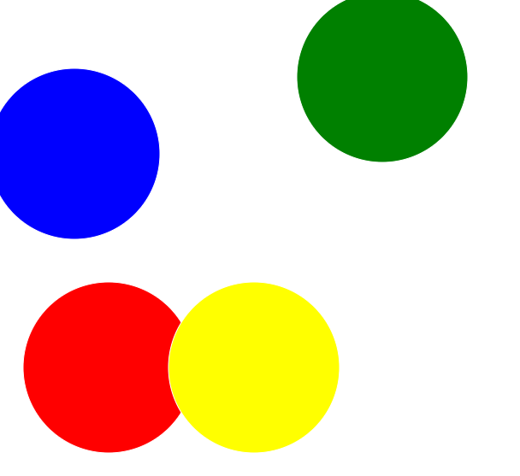

BLUES turn RED after their days are up (models symptomatic of pos test)
REDs are SPREADERS for [days]

Slide 6
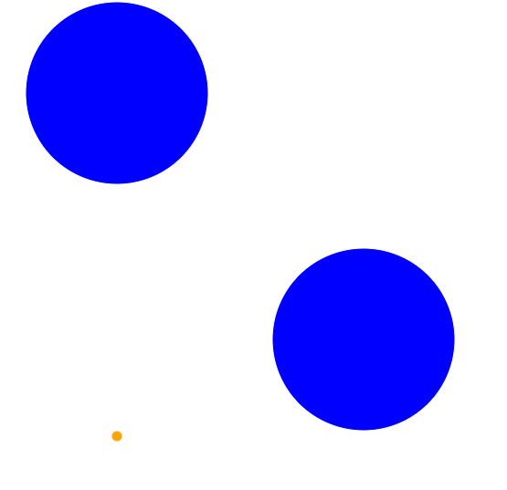
REDs turn orange and INERT
NO LONGER A TRANSMITTER IN CIRCULATION IN THE POPULATION

Slide 7

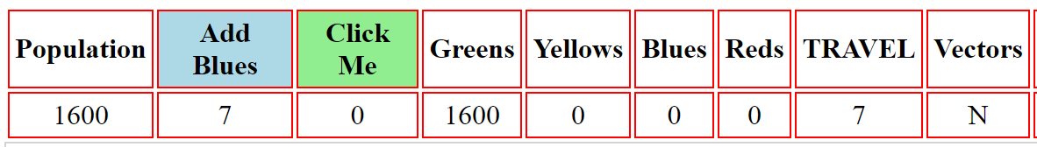
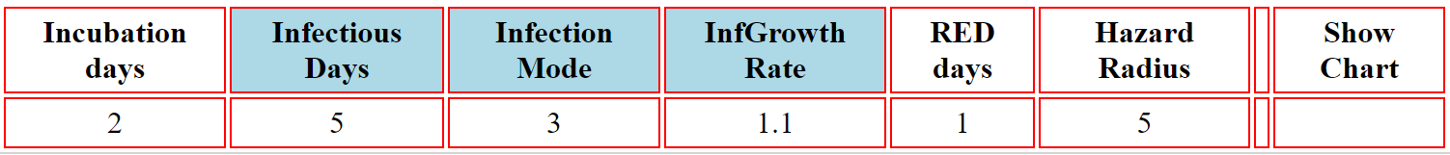
TO START
1. INITIALIZE POPULATION (max = 7000)
2. Add number of BLUE transmitters (default = 7)
3. ADVANCE each day manually by clicking on the “CLICK ME” button
- each entity moves a random amount, and collisions are
detected for transitions if any
The default FULL MENU looks like this (left half)
and

Slide 8
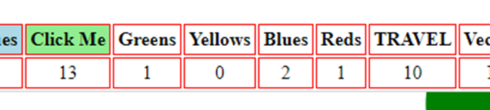
DAILY COUNTS each CLICK
EACH time you click, the counter advances by one time period
Each time period shows, at its beginning, the numbers of:
GREENS – still not infected
YELLOWS – infected and incubating
BLUES – infected and capable of spreading
REDs – detected (symptoms or test) but still
spreading until they turn ORANGE (inert)
- presently this count includes ORANGEs

Slide 9

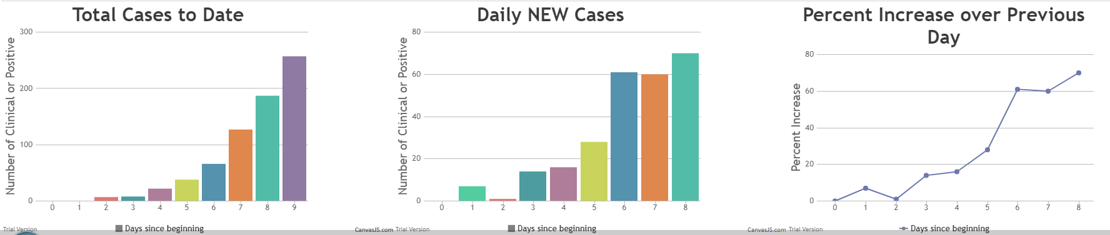
Visualize Data as Charts
AT ANY TIME, CLICK ON “SHOW CHARTS” AND SCROLL DOWN TO SEE
YOU CAN CHANGE THE PARAMETERS AT ANY STEP AND WATCH THE EPIDEMIC
SPEED UP OR SLOW DOWN but the charts do not update automatically

Slide 10
Hazard Radius
- the larger this is, the more likely the collisions (infections)
- so decreasing this can reduce transmission to GREENs
- this can be done in the course of running the model
- and watching the change in the CHARTs and counts
EXAMPLES – follow in real time by downloading CovidSim.html
here: http://s000.tinyupload.com/?file_id=10163614289139522296
OPEN in a browser like CHROME or FIREFOX, EDGE

Slide 11
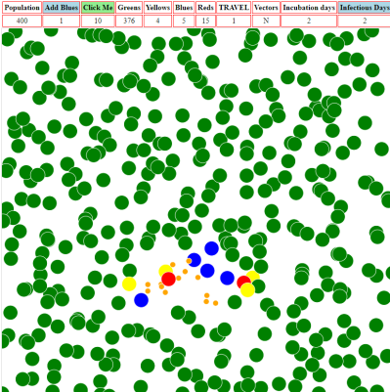
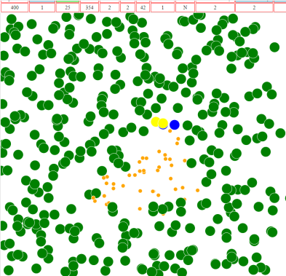
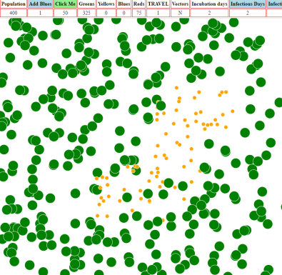
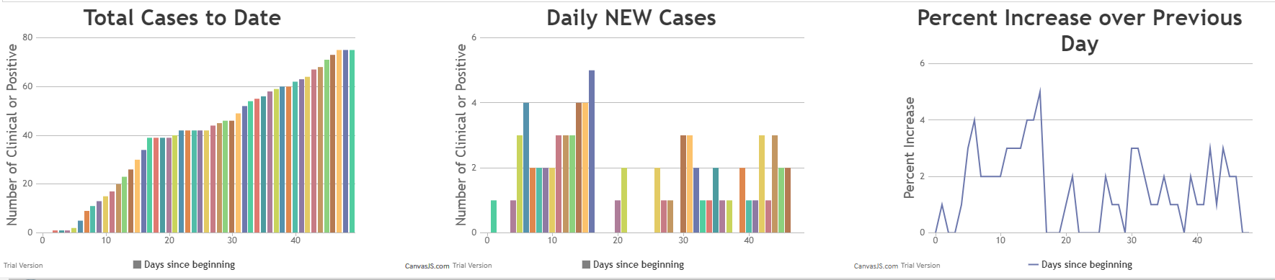
Trial 1 – High Hazard Radius Low Travel
Population = 400 BLUES=1 TRAVEL=1 Incubation=2 Infectious Days=2 Hazard=14
10 days 25 days 50 days
localized still localized self-limiting

Slide 12
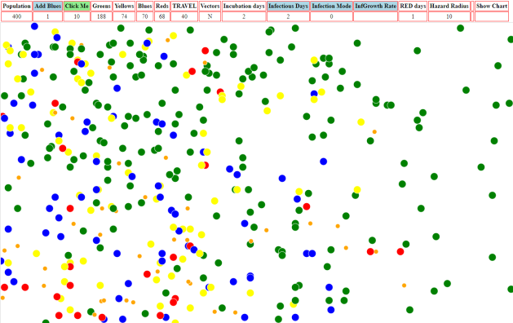
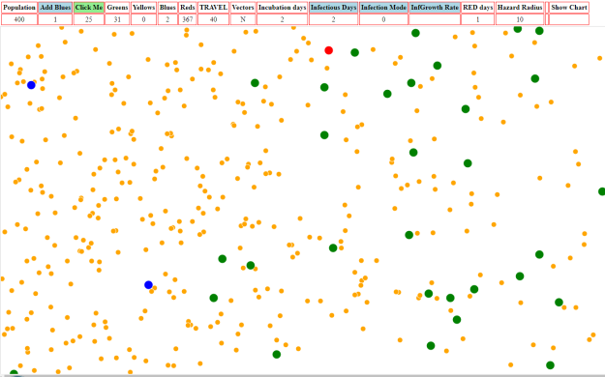
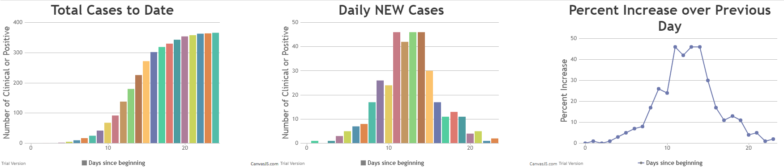
Trial 2 – Medium Hazard Radius High Travel
Population = 400 BLUES=1 TRAVEL=40 Incubation=2 Infectious=2 Hazard=10
10 days 25 days
widely dispersed few uninfected left (31)
The decrease in new rates is due to running out of susceptibles

Slide 13
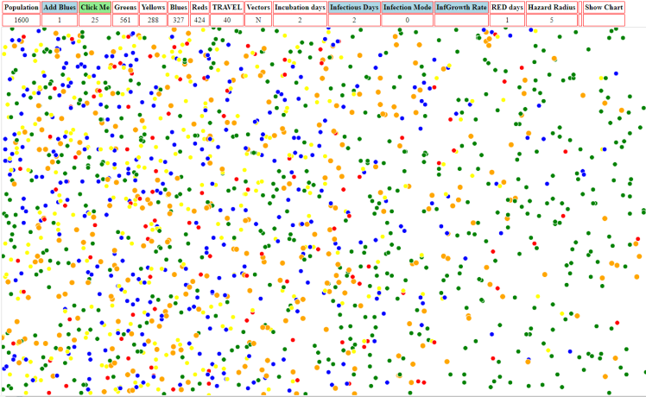
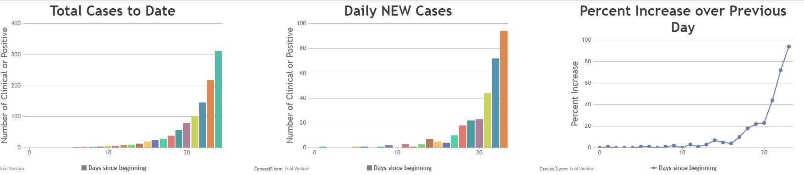
Trial 2a – Test running out hypothesis
Population = 1600 BLUES=1 TRAVEL=40 Incubation=2 Infectious=2 Hazard=10
SAME PARAMETERS LARGER POPULATION
25 days
561 GREENS left from 1600
288 YELLOWS (incubating)
327 BLUEs (infective but not detected)
424 REDS (infective and detected)
Obviously, the rates are still increasing and these parameters were not
self-limiting except for susceptibles

Slide 14
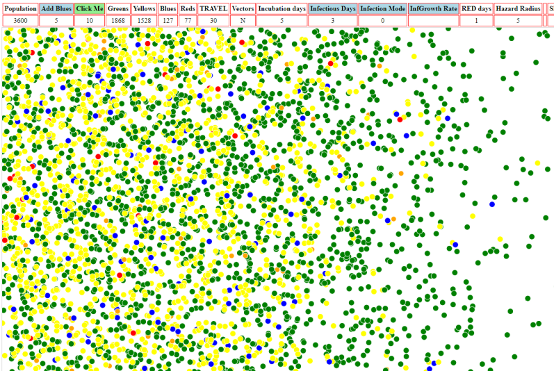
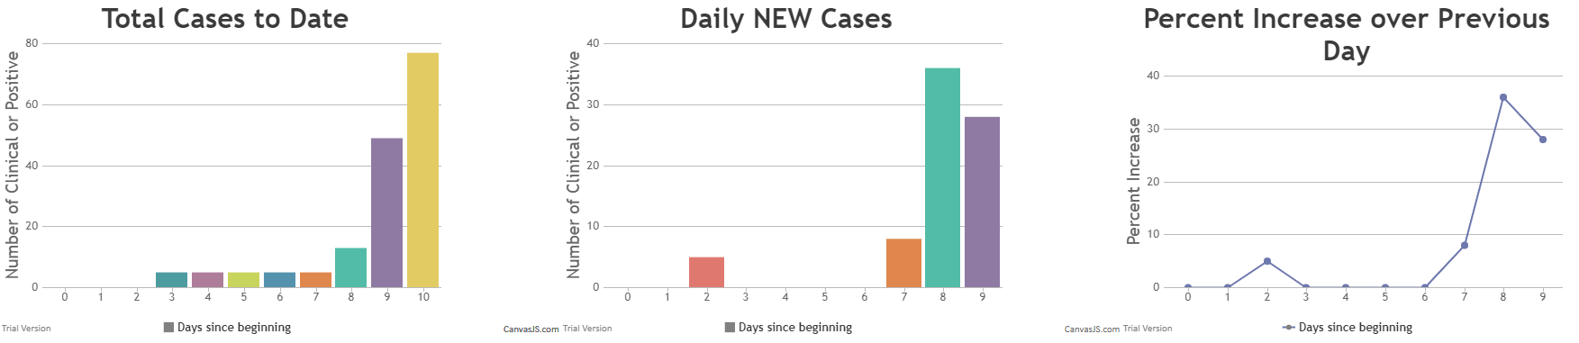
Rampant Epidemic
Population = 3600 BLUES=5 TRAVEL=30 Incubation5 Infectious=5 Hazard=10
After 10 cycles
widely dispersed
only 77 REDs
but 127 BLUEs
and 1528 YELLOWS (incubating)
with 1868 GREENs left (of 3600)
The Total Case pattern is familiar – and the new cases do not seem remarkable
but the day over day new-case rise has reached 35%

Slide 15
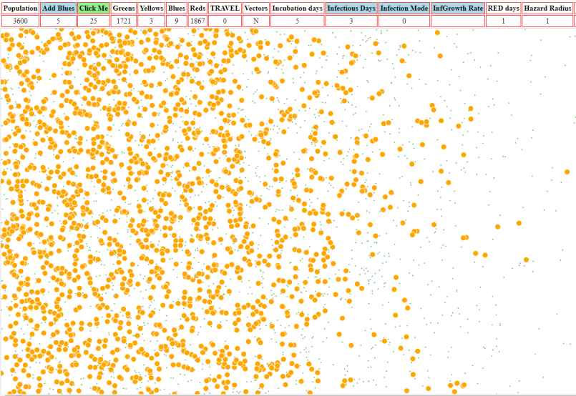
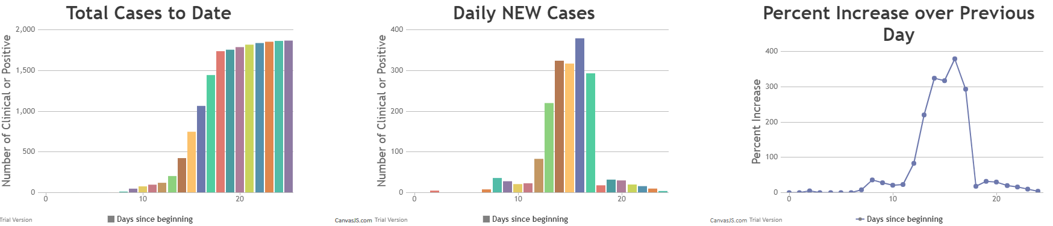
Rampant Epidemic + Intervention
Population = 3600 BLUES=5 TRAVEL=0 Incubation5 Infectious=5 Hazard=1
Change parameters at cycle 10
Now at cycle 25
(ORANGES are inert REDs)
Total of 77 REDs
only 9 BLUEs
only 3 YELLOWS (incubating)
and 1721 GREENs left (of 3600)
Intervention
Intervention was at Day10 – and the massive surge following that is due to
all the infected and incubating that existed at time of intervention

Slide 16
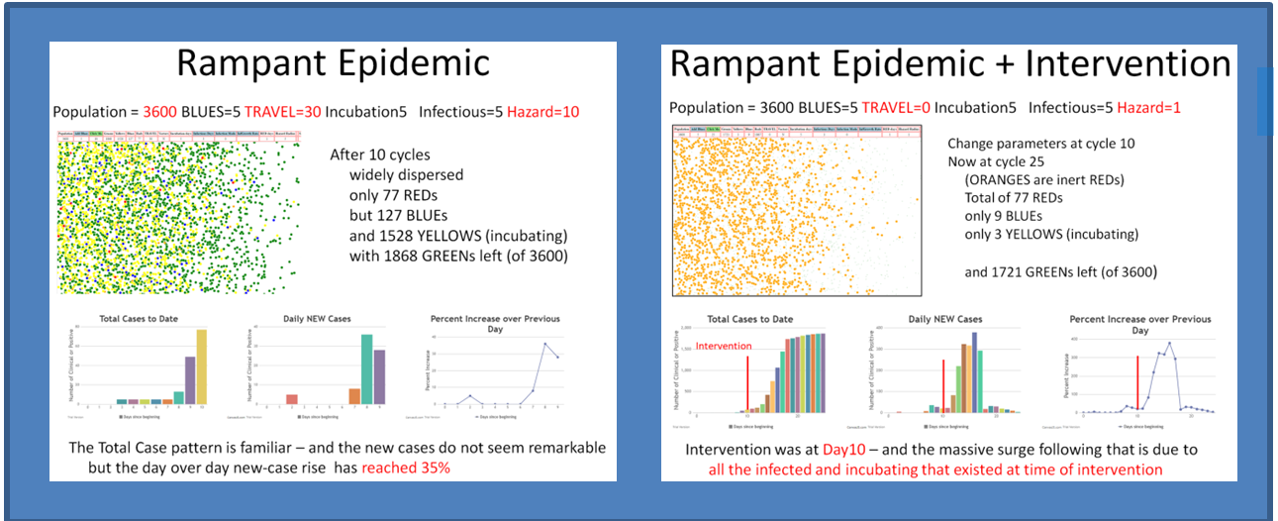
SEEING THEM SIDE BY SIDE
The April 7th version of CovidSim supports animation and simulation intervals

Slide 17
CONCLUSION
Thank you for your attention
You can download the CovidSim.html from this link:
http://s000.tinyupload.com/?file_id=10163614289139522296
which takes you to a tinyupload.com page with the actual link
If you need to contact me, try @EC_GO on twitter
PLEASE feel free to modify the Javascript code for improvements (eg animation)
and to pass this presentation and the CovidSim on to others
PS see next slide for explanation of VECTOR and MODE of transmission

Slide 18
MODE and Vector
MODE is more important – to model whether the infectivity increases
after turning BLUE (becoming able to spread)
default set at MODE=3 with daily increase rate of 1.1 (10% compounded)
other MODES are:
0 constant infectivity
1 over duration of being BLUE, infectivity increases
linearly so the total increase is 2X
2 same as [1] but the total increase is 3X
VECTOR – for visualizing DISTANCE travelled, shows the line and direction
taken from the last position of an entity….and two ORANGE and
one BLACK entity are there for tracking….the colors in VECTOR are
otherwise related to distance travelled, not infection status
BEST TO IGNORE VECTOR AND LET IT BE “N”

